Slide 1
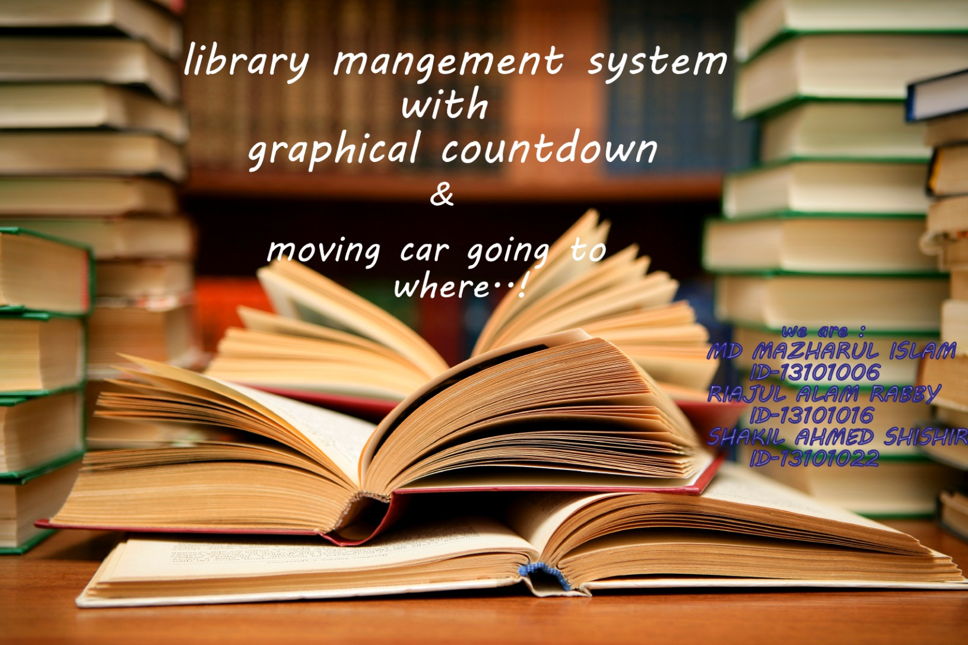
Course Teacher : MD ASIFUL HOSSAIN ASIF

Slide 2
CONTENT
Introduction
Features
Applications
Equipment's
Flow Charts
Information
Motivations
Conclusion

Slide 3
FEATURES
Well organised management
Search option enable
User friendly
Select option enable
Categorical selection
Data monitoring facilities
Visible countdown in graphics
Graphical moving car

Slide 4
APPLICATIONS
Workable for almost every library
School , College , University, Public Library etc…
Useable for bookshop also

Slide 5
EQUIPMENTS
Code Blocks
Dev C++
Notepad
MinGW
New Used Header file
Graphics.h
Windows.h

Slide 6
Flow charts

Slide 7
MOTIVATION
Will be a mega project
Data store feature will be added
Data edit feature
Searching option {by name , id , author name }
Will be more visually strong and more understandable
More user friendly
Available in application
Graphical view of project will be available
In Graphics project graphical view will be more realistic

Slide 8
Project was supervised by Sir Asif Hossain , lecturer of CSE department.
www.programmingsimplified.com and secondary help from web..

Slide 9


Slide 10
Thank You
☺

Slide 11
ANY QUESTION… ?
Question will be answered by team members.

